Slide 1

Employee Data Analysis using Excel
STUDENT NAME: SAVITRI
REGISTER NO: 312209171 NAAN MUDALVAN ID:asunm1353312209171
DEPARTMENT : B.Com (Commerce)
COLLEGE: ANNA ADARSH COLLEGE FOR WOMEN

Slide 2

PROJECT TITLE
Employee Performance Analysis using Excel

Slide 3

AGENDA
Problem Statement
Project Overview
End Users
Our Solution and Proposition
Dataset Description
Modelling Approach
Results and Discussion
Conclusion

Slide 4

PROBLEM STATEMENT
Analyzing employee data sets is crucial for several reasons:
Improving Employee Experience
Enhancing Productivity
Informed Decision-Making
Identifying Trends and Patterns
Ensuring Fairness and Compliance
Strategic Planning

Slide 5
WHO ARE THE END USERS?
Employee performance analysis is valuable tool for various stakeholders within an organization. Here are some of the key end users:
Human resource department
Managers and team leaders
Executives and senior management
Employees
Training and development teams
Data analysts

Slide 6

PROJECT OVERVIEW
Comprehensive Performance Analysis Project Overview
Objective: Analyze [Companies’s financial, operational, customer, and market performance to inform strategic decisions.
Scope: Financial, operational, customer, and market analysis.
Deliverables: Report, KPI dashboard, recommendations, and presentation.
Timeline: 6 weeks.
Resources: Project lead, data analyst, subject matter experts, and company data.
Methodology: Data analysis, benchmarking, stakeholder feedback, and root cause analysis.
This project aims to provide a thorough understanding of the company's performance and identify areas for improvement.

Slide 7
OUR SOLUTION AND ITS VALUE PROPOSITION
SOLUTION FOR EMPLOYEE PERFORMANCE ANALYSIS
Data collection and integration
Performance metrics
Advanced analytics
Personalised insights
Continuous feedback and improvement
VALUE PROPOSITION
Enhanced productivity
Employee engagement and retention
Data-driven decisions
Improved organizational performance
Scalability and flexibility

Slide 8

Dataset Description
Employee data set : Kaggle https://www.kaggle.com/datasets/tawfikelmetwally/employee-dataset
26 Features
9 Features
Employee ID: Num
Name: Text
Employe Type
Performance level
Gender: Male, Female, All

Slide 9

THE "WOW" IN OUR SOLUTION
Formula used for finding the performance levelof employees
=IFS(Z8>=5,"VERY HIGH",Z8>=4,"HIGH",Z8>=3,"MED",Z8>=2,"LOW",Z8>=1,"VERY LOW")
3/21/2024 Annual Review
9

Slide 10
MODELLING
DATA COLLECTION
Downloaded the data set from Edunet dashboard
Opened the data in excel
Saved the file in the desktop as an (.xls) file
FEATURE COLLECTION
Used conditional formatting
Used fill color option
used filter option to separate blanks in the column
DATA CLEANING
filtering the data according tour needs
making the data into a structured data
and separating the important columns
10

Slide 11
Pivot TABLE
Taking out the business unit, gender code, first name, and performance level
Removing all the blank value by using filter option.
And your pivot-table is ready.
GRAPH
Used for the visual representation of the table to give us a clear view of the employe
Can depict increase or decrease in the performance level

Slide 12
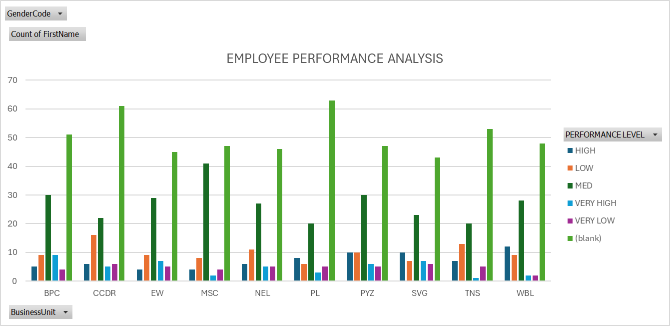
RESULTS
12

Slide 13
RESULTS

Slide 14
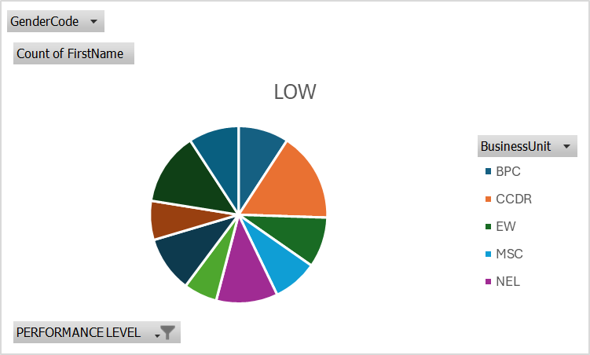
RESULTS

Slide 15
CONCLUSION
The highest performance level is WBL
THE LOWEST PERFORMANCE LEVEL IS PL

